Slide 1

LED BLINKING CIRCUIT Presented by:- Aman kumar CS(IOT)

Slide 3
OBJECTIVE: TO DEMONSTRATE THE
PRINCIPLES OF BASIC ELECTRONICS,
PARTICULARLY USE OF 7805 IC OR
MICROCONTROLLER TO CONTROL ON /OFF
CYCLE OF LED.
• Understanding Basic Circuitry:
• The project introduces fundamental concepts like resistors, capacitors, LEDs, and
transistors (if used).
• Learning about Timing Circuits:
• A key aspect is understanding how microcontroller generates the timing signals that
control the LED’s blinking frequency.

Slide 4
COMPONENTS USED : Essential Components: LED (Light Emitting Diode): The component that produces light when current flows through it. Resistor: Limits the current flowing through the LED, preventing it from burning out. Power Source: Provides the electrical energy to operate the circuit (e.g., battery). Jumper Wires: Connects the components on a breadboard or other prototyping platform.

Slide 5
OBJECTIVE: TO DEMONSTRATE THE
PRINCIPLES OF BASIC ELECTRONICS,
PARTICULARLY USE OF 7805 IC OR
MICROCONTROLLER TO CONTROL ON /OFF
CYCLE OF LED.
• Understanding Basic Circuitry:
• The project introduces fundamental concepts like resistors, capacitors, LEDs, and
transistors (if used).
• Learning about Timing Circuits:
• A key aspect is understanding how microcontroller generates the timing signals that
control the LED’s blinking frequency.

Slide 6
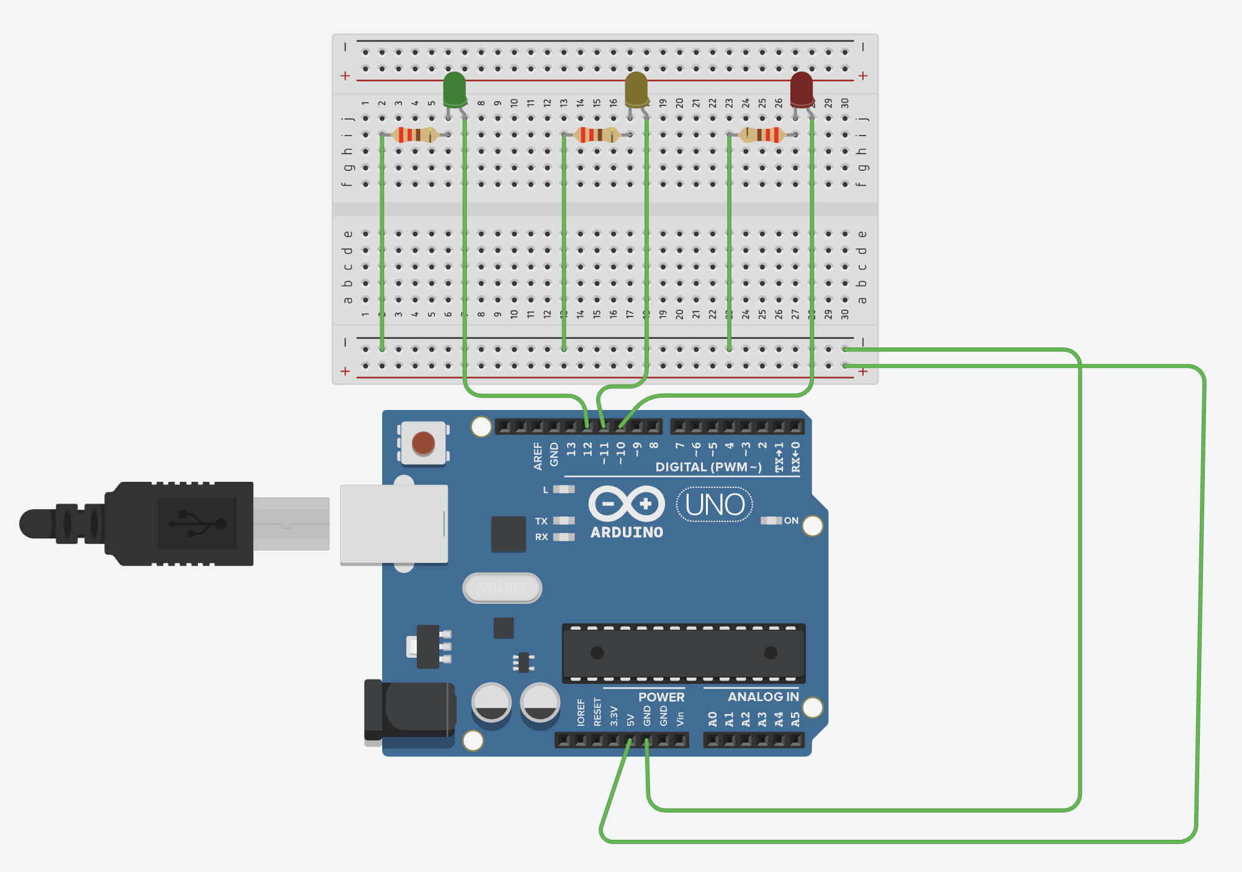
CIRCUIT DIAGRAM:

Slide 7
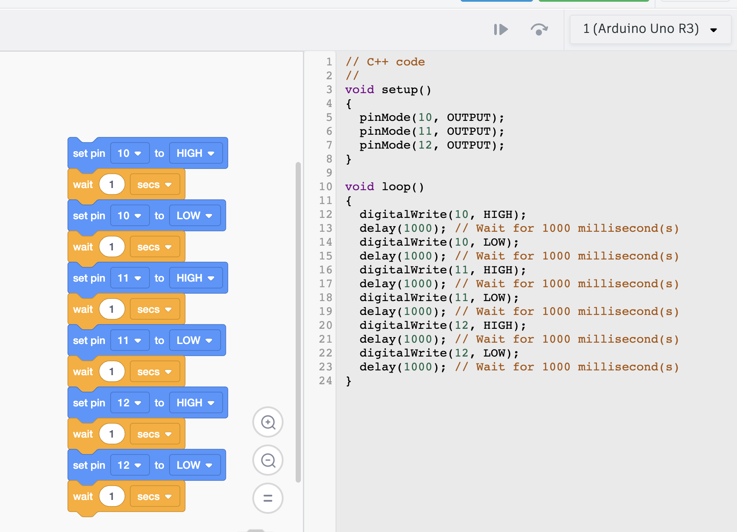
BLOCK CODE:

Slide 8
CONCLUSION:
• Component functionality: Understanding how transistors, resistors, capacitors, and
diodes work together.
• Circuit analysis: Learning to predict and analyze the behavior of simple circuits.
• Troubleshooting: Developing skills to identify and fix potential issues in the circuit.

Slide 9


